Slide 1

Building Your Own Connector
Bogdan Sucaciu
TECH LEAD @ AXUAL
@BSucaciu bsucaciu.com

Slide 2

Warning!
Proceed with caution!

Slide 3
Check First
Go to Confluent Hub Make a Google search

Slide 4
Make it Generic
Don’t overly customize it

Slide 5


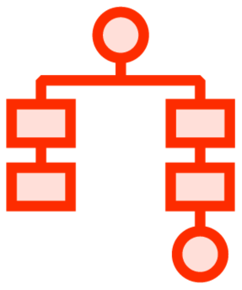

Building Your Own Connector
How to ingest data?
What does my data look like?
Source Connector
More complex and less straightforward
When to ingest data?

Slide 6
Partitioned Streams

Slide 7

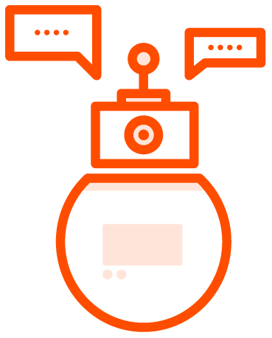

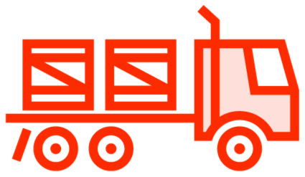




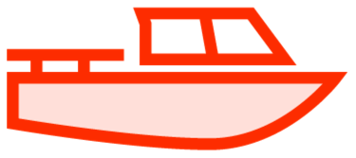
Data Stream
…
…

Slide 8






Partitioned Stream
… |  | …
… |  | …
…
…

Slide 9


Apache Kafka & Data Streams
Kafka Connect
Apache Kafka
Task 0
Partition 0
Partition 1
Task 1
Partition 2
……………………...…....…......

Slide 10

Apache Kafka & Data Streams
Kafka Connect
Apache Kafka
Task 0
Partition 0
Partition 1
Task 1
Partition 2
……………………...…....…......

Slide 11



Apache Kafka & Data Streams
Kafka Connect
Apache Kafka
Task 0
Partition 0
Partition 1
Task 1
Partition 2
……………………...…....…......

Slide 12


Apache Kafka & Data Streams
Kafka Connect
Apache Kafka
Task 0
Partition 0
Partition 1
Task 1
Partition 2
……………………...…....…......
Task Partitioning
Default / Custom Partitioner
Single Message Transform

Slide 13
Partitioning Strategies
Functional
Vertical
Horizontal

Slide 14
Horizontal Partitioning Strategy
articles
Task 0
id author 1
2
3
4
title
diagram
body
footnote
1
2
Task 1
3
4
#task = hash(key) % nbOfTasks

Slide 15
Vertical Partitioning Strategy
articles
Task 0
author title diagram
id author 1
2
3
4
title
diagram
body
footnote
Task 1
body
footnote

Slide 16
Functional Partitioning Strategy
articles
Task 0
id author 1
2
title
diagram
body
footnote
articles
Task 1
ratings
id article_id 1
2
ratings
user_id
rating

Slide 17
Which one should you pick?
... it depends!

Slide 18
Partitioning Strategies
Functional
Vertical
Horizontal

Slide 19
Config Validation & Schemas

Slide 20
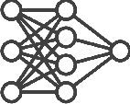
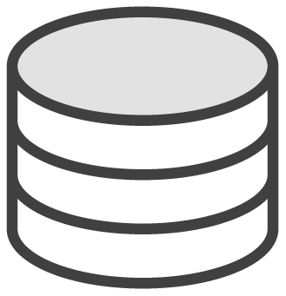
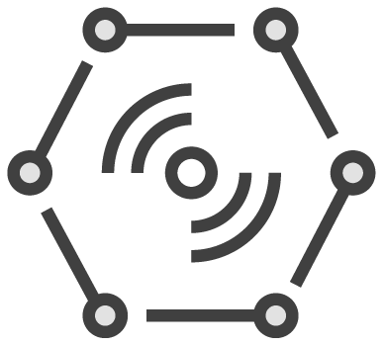
Kafka Connect Configuration
Connector Instance
T
SC
C
T
T
Source
Kafka Broker
Configuration
Nb. of Tasks
Connection Configuration Single Message Transforms Converters
SC
- Source Connector
T
- Single Message Transform (SMT)
C
- Converter

Slide 21
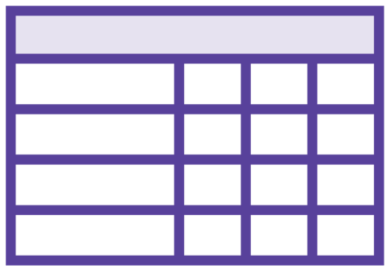
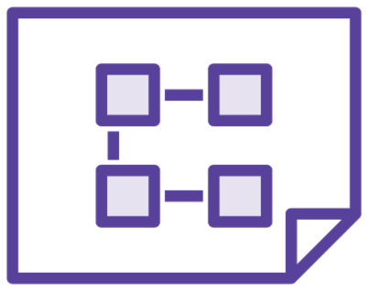

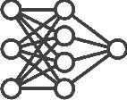

Schemas
Database Table
Connector Instance
T
SC
C
T
T
Source
Kafka Broker
SC
- Source Connector
T
- Single Message Transform (SMT)
C
- Converter

Slide 22
Primitive Schema Types
Kafka Connect Schema | Java
INT8 | Byte
INT16 | Short
INT32 | Integer
INT64 | Long
FLOAT32 | Float
FLOAT64 | Double
BOOLEAN | Boolean
STRING | String
BYTES | Byte

Slide 23
Complex Schema Types
Kafka Connect Schema
ARRAY
MAP
Struct
Java
Array Map Object
Optional *
Object || Null

Slide 24

Building Weather Connector
Open Weather Map
Demo
Defining Config
Creating Schemas Prerequisites:
- Java

Slide 25
Connectors & Tasks

Slide 26

Connectors
Connector Instance
T
D
C
T
T
Database
Connector Instance
T
Kafka Broker(s)
E
C
T
Search Engine
D
Database Connector
Search Engine Connector
E
T
- Single Message Transform (SMT)
C
- Converter

Slide 27
Connectors
MySourceConnector.java
public class MySourceConnector extends SourceConnector { @Override
public void start(Map<String, String> props) {}
@Override
public Class<? extends Task> taskClass() {}
@Override
public List<Map<String, String>> taskConfigs(int maxTasks) {}
@Override
public void stop() {}
@Override
public ConfigDef config() { }
@Override
public String version() {}
}

Slide 28
Connectors
MySourceConnector.java
MySinkConnector.java
public class MySourceConnector extends SourceConnector {
@Override
public void start(Map<String, String> props) {}
@Override
public Class<? extends Task> taskClass() {}
@Override
public List<Map<String, String>> taskConfigs(int maxTasks) {}
@Override
public void stop() {}
@Override
public ConfigDef config() { }
@Override
public String version() {}
}
public class MySourceConnector extends SinkConnector {
@Override
public void start(Map<String, String> props) {}
@Override
public Class<? extends Task> taskClass() {}
@Override
public List<Map<String, String>> taskConfigs(int maxTasks) {}
@Override
public void stop() {}
@Override
public ConfigDef config() { }
@Override
public String version() {}
}

Slide 29

Connectors
MySourceConnector.java
public class MySourceConnector extends SourceConnector {
@Override
public void start(Map<String, String> props) {}
@Override
public Class<? extends Task> taskClass() {}
I’m version 1.0 !
@Override
public List<Map<String, String>> taskConfigs(int maxTasks) {}
@Override
public void stop() {}
@Override
public ConfigDef config() { }
@Override
public String version() {}
}

Slide 30
Connectors
MySourceConnector.java
public class MySourceConnector extends SourceConnector {
@Override
public void start(Map<String, String> props) {}
@Override
public Class<? extends Task> taskClass() {}
{
"name": "articles-connector", "config": {
"connector.class": "io.debezium.connector.mysql.MySqlConnector",
"tasks.max": "1",
"database.server.id": ”223344", "database.server.name": "globomantics”,
...
}
}
@Override
public List<Map<String, String>> taskConfigs(int maxTasks) {}
@Override
public void stop() {}
@Override
public ConfigDef config() { }
@Override
public String version() {}
}

Slide 31


Connectors
MySourceConnector.java
public class MySourceConnector extends SourceConnector {
@Override
public void start(Map<String, String> props) {}
@Override
public Class<? extends Task> taskClass() {}
Connector! start()
@Override
public List<Map<String, String>> taskConfigs(int maxTasks) {}
@Override
public void stop() {}
@Override
public ConfigDef config() { }
We are able to communicate!
Initializing connection!
@Override
public String version() {}
}

Slide 32

Connectors
MySourceConnector.java
public class MySourceConnector extends SourceConnector {
@Override
public void start(Map<String, String> props) {}
@Override
public Class<? extends Task> taskClass() {}
Connector! stop()
@Override
public List<Map<String, String>> taskConfigs(int maxTasks) {}
@Override
public void stop() {}
@Override
public ConfigDef config() { }
Bye! Bye!
@Override
public String version() {}
}

Slide 33
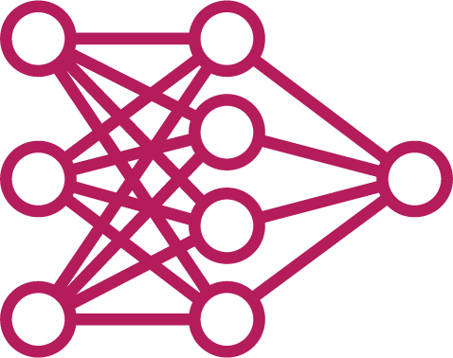
Connectors
MySourceConnector.java
public class MySourceConnector extends SourceConnector {
@Override
public void start(Map<String, String> props) {}
@Override
public Class<? extends Task> taskClass() {}
I’m going to use this task class!
@Override
public List<Map<String, String>> taskConfigs(int maxTasks) {}
@Override
public void stop() {}
@Override
public ConfigDef config() { }
MySourceTask.java
@Override
public String version() {}
}

Slide 34
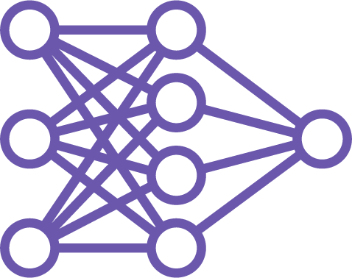
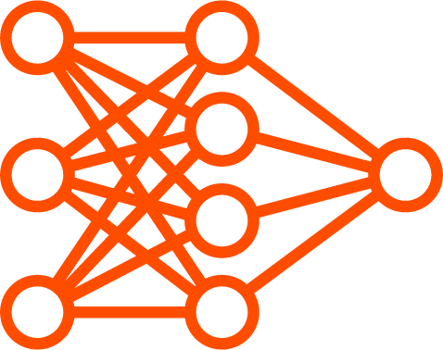
Connectors
MySourceConnector.java
public class MySourceConnector extends SourceConnector {
@Override
public void start(Map<String, String> props) {}
@Override
public Class<? extends Task> taskClass() {}
@Override
public List<Map<String, String>> taskConfigs(int maxTasks) {}
@Override
public void stop() {}
@Override
public ConfigDef config() { }
@Override
public String version() {}
}

Slide 35
Source Tasks
MySourceTask.java
public class MySourceTask extends SourceTask {
@Override
public void start(Map<String, String> props) { }
@Override
public List<SourceRecord> poll() throws InterruptedException { }
@Override
public void stop() { }
@Override
public String version() { }
}

Slide 36

Source Tasks
MySourceTask.java
public class MySourceTask extends SourceTask {
@Override
public void start(Map<String, String> props) { }
@Override
public List<SourceRecord> poll() throws InterruptedException { }
@Override
public void stop() { }
@Override
public String version() { }
}
I’m version 1.0 !

Slide 37



Source Tasks
MySourceTask.java
public class MySourceTask extends SourceTask {
@Override
public void start(Map<String, String> props) { }
@Override
public List<SourceRecord> poll() throws InterruptedException { }
@Override
public void stop() { }
@Override
public String version() { }
}
Setup config
Initialize connection
Check previous contexts

Slide 38


Source Tasks
MySourceTask.java
public class MySourceTask extends SourceTask {
@Override
public void start(Map<String, String> props) { }
@Override
public List<SourceRecord> poll() throws InterruptedException { }
@Override
public void stop() { }
@Override
public String version() { }
}
Source
Kafka Connect

Slide 39

Source Tasks
MySourceTask.java
public class MySourceTask extends SourceTask {
@Override
public void start(Map<String, String> props) { }
@Override
public List<SourceRecord> poll() throws InterruptedException { }
@Override
public void stop() { }
@Override
public String version() { }
}
Source
Kafka Connect

Slide 40
Sink Tasks
MySinkTask.java
public class MySinkTask extends SinkTask {
@Override
public void start(Map<String, String> props) { }
@Override
public void put(Collection<SinkRecord> records){ }
@Override
public void stop() { }
@Override
public String version() { }
}

Slide 41
Sink Tasks
MySinkTask.java
public class MySinkTask extends SinkTask {
@Override
public void start(Map<String, String> props) { }
@Override
public void put(Collection<SinkRecord> records){ }
@Override
public void stop() { }
@Override
public String version() { }
}

Slide 42
Demo
Create Connector & Task
Deploy our new connector

Slide 43

Summary
Partitioned Streams
Steps for building connectors and tasks Created our own Weather Connector

